Slide 1

FEEDBACK ON THE MOMBASA COUNTY FISCAL STRATEGY PAPER 2018
James Muraguri
CEO, IPFK jmuraguri@ipfkenya.or.ke

Slide 2
Key Decisions for the CFSP 2018
The sector distribution of the budget

Slide 3
Key Decisions for the CFSP 2018
How government is dealing with challenges in budget implementation
Low revenue collection is a challenge in the budget implementation. The county will address this by :
mapping new sources of revenue for example betting and gaming, liquor licensing
automation of revenue collection
the monitoring of the revenue points.
Decentralization of revenue collection at the sub- county and ward levels.

Slide 4
Key findings
Expenditure pressures relate to the rising wage bill resulting from personnel emoluments (para 29)
No clear solution to address the identified challenges: Wage bill ((para 78), shortfall in revenue, pending bill ( statutory deductions)
In tight operating environment, compliance to statutory deadlines has been achieved on the CFSP submission deadline
Notes:
Deficiencies ….Lacks indicators and targets

Slide 5
Key findings
Frequent downing of Integrated Financial Management Information (IFMIS) to the main server at the National Treasury. (para 30)
Inability to know if previous BAC committee recommendations have been implemented.
Non adherence to budget preparation and implementation guidelines by departments (para 31)

Slide 6
Key findings
Absence of comparative data between last year’s priorities to this year’s to confirm any changes. Lack of comparison data for sector ceilings and projections to facilitate tracking any changes over the previous financial years
Revenue projections: Unexplained Difference of KES 149 Million between the Mombasa CFSP 2018 and Budget Policy Statement 2018.
The county has failed, historically, to achieve its local revenue targets as shown in the table below

Slide 7
County Total Revenue
The county has projects a budget of Ksh13 billion in the FY2018/19. To finance the budget, the county expects to collect Ksh4 billion from local sources, receive Ksh8.1 billion as equitable share from the National Government and Ksh900 million as conditional grants. (as shown in Table 4)

Slide 8
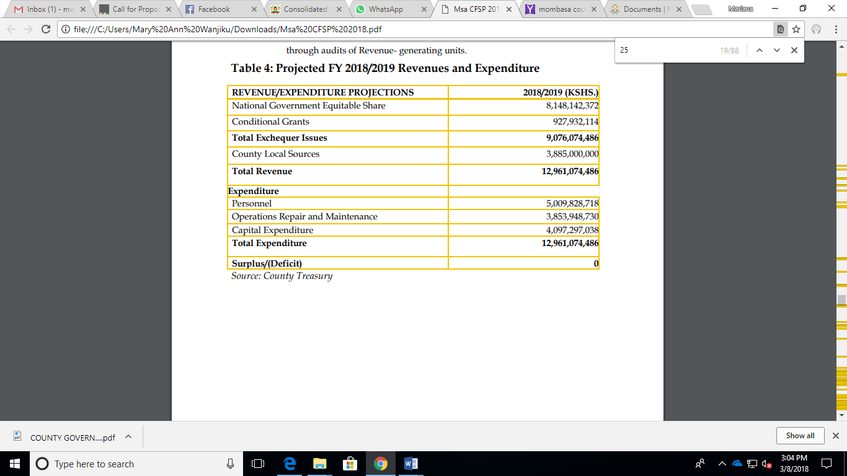
County Total Revenue

Slide 9
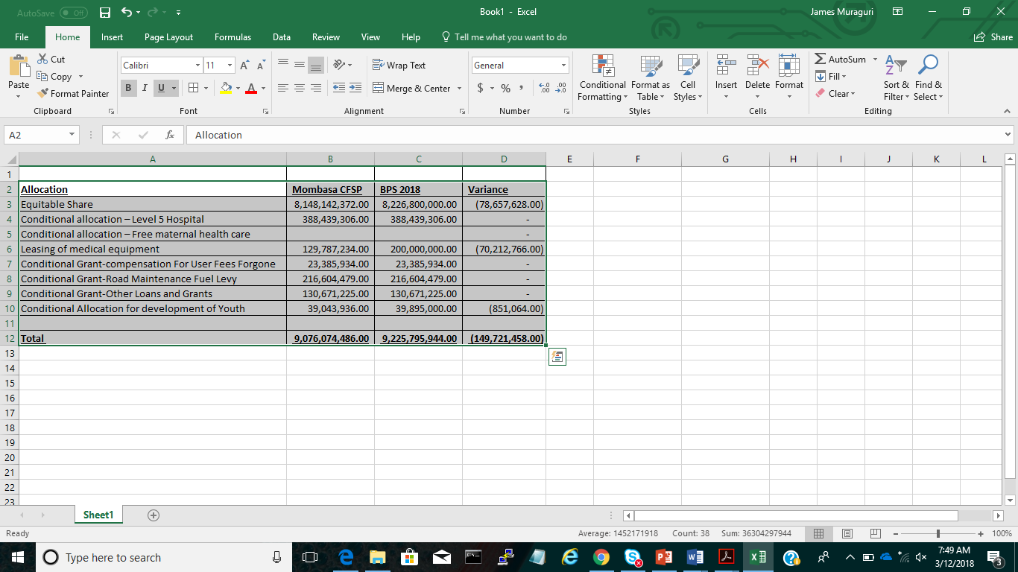
Allocation Variance Mombasa CFSP 2018 Vs BPS 2018

Slide 10
Local Revenue
The county expected to raise Ksh3.5 billion in FY 2017/18.
As at 30th December 2017, the county had collected Ksh578, 260,262

Slide 11
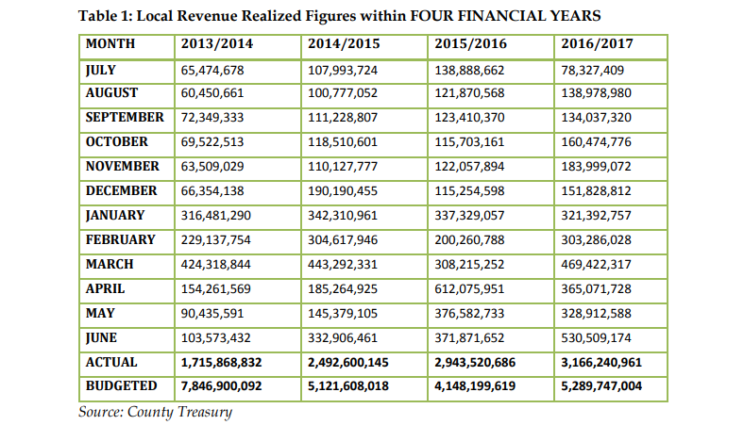
Local Revenue

Slide 12
SECTOR DISTRIBUTION OF THE COUNTY BUDGET FY 2018/19

Slide 13
Health Department
The department has been allocated Kshs3,155,800,846 in FY 2018/2019. The allocation consists of 24.3% of the total county budget.
The CFSP is not clear on the programmes under the health Department as well as allocations thereof.

Slide 14
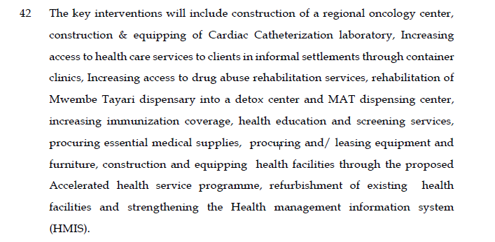
PRIORITIES

Slide 15
Public Participation
County reports that various stakeholders were consulted in the preparation of the CFSP.
There was as also an invite in the local dailies which was followed by mobile public address systems to sensitize the citizens to attend the forum.
It is however not clear if and how the views of the different stakeholders were considered in the CFSP.

Slide 16
CONCLUSION and RECOMMENDATION:
Continuous allocation of resources based on equality does not provide for equitable distribution of public resources
  There is need for the county to consider proper and scientific means of distributing resources across the county
  The county should request for proper audit of the bursary fund to identify areas of improvement including wards that are not fully utilizing resources and make appropriate recommendations.

Slide 17
CONCLUSION and RECOMMENDATION:
The county should adopt a program-based format in the sector allocations e.g. the Health sector, the CFSP should have broken down its expenditure into programs such as administrative, preventive and curative measure

Slide 18
CONCLUSION and RECOMMENDATION
Cross- County short and long term interventions should be adequately financing.( para 56). Outbreak of diseases like Chikunyanga and malaria require joint efforts. The CFSP 2018 does not address how this will be handled based on 2017 lessons. Uniqueness of Mombasa due to coastal resort status.

Slide 19
CONCLUSION and RECOMMENDATION:
Availability of prior financial year’s data is important in funds allocation with respect to making informed decisions
The county should strive to set realistic revenue targets to guide their expenditures

Slide 20
CONCLUSION and RECOMMENDATION:
County budget implementation reports not available to the public and on time.
  An affront to Section 166 (4) (a) of the PFM Act 2012 which requires the county treasury to “not later than one month after the end of each quarter, consolidate the quarterly reports and submit them to the county assembly;”

Slide 21
CONCLUSION and RECOMMENDATION:
Need to Prepare of citizens budget as required by PFM Act 2012 ( county government regulations)

